Slide 1
A Low-Complexity Design for Complex Multiplication using Radix-4 Booth Encoding
Name: Dhruva Sharma
Enrollment No: 23123016
Email id: dhruva_s@ece.iitr.ac.in
Name: Sneha Kandpal
Enrollment No: 23116092
Email id: sneha_k@ece.iitr.ac.in

Slide 2
Agenda
Motivation
Problem statement
Block Diagram
Design Procedure
Simulation Results
FPGA Implementation
Comparison with other designs (If Done)
Conclusion
References

Slide 3

Motivation-Why do we care about this?
Complex multiplication isn't just abstract math; it's the engine behind modern technology.
Where is it Used?
Communications: 5G, Wi-Fi, and radar systems all rely on it to process signals.
Signal Processing (DSP): Essential for audio, video,and medical imaging (like MRIs). (80% of FFT Cycles are essentially complex multiplications).
The Engineer's Trilemma: For any hardware design, we are always fighting to improve three things -
Latency
Power consumption
Area
This paper improves upon all three factors than previous existing architectures.
where, a,b,c, and d are M-bit fixed-point numbers.

Slide 4


Literature Review
Naive Implementations:
The Naive Design: 4 Multipliers with 2 Adders (Delay : Tm+Ta):
Gauss algorithm: Slightly better with improved area (3 multipliers with the addition of two more adders), but worse delay (Tm + 2Ta).
Better than previous (3 multipliers but with only 2 wide (2N- bit) adders compared to previous with 3 wide adders).
The Bottleneck: Digital Multiplication is slow!
(N² partial products for N bit multiplication).
Existing Architectures:
Method | Pros | Cons
Vedic real multiplication | Fast | Unsigned only; no sign extension.
Booth Encoding + Wallace Multiplier | Area-time savings | [4]: 2 encoders + 4 CS trees + 4 VMAs + 2 adds/subtracts. [5]: 4 encoders (higher area).
Recursive CORDIC | Low area | 10x slower latency.
Compressors for partial product reduction | High-speed, low-power | Still uses 4 multipliers; direct equation (1).
Existing high-performance designs use a two-stage adder—first computing products like ac and bd, then performing a subtraction (ac − bd), which adds delay and limits speed.

Slide 5
Problem statement
The paper addresses the need for a low-complexity, faster, and more power-efficient hardware architecture for complex multiplication.
Limitations in existing designs:
Large area because of multiple Booth encoders, multiple multipliers.
High delay due to two-stage adder structure (Wallace → Vector Merging → Final Adder).
Inefficient partial product handling.
Designs do not scale well for 16/32-bit word lengths.
Goal of the paper:
To design a compact, high-speed, Booth-encoded, Distributed-Arithmetic-based complex multiplier for M=8, 16, 32 bits with:
Reduced partial products.
Shared resources.
No vector-merging adder.
Lower area-delay product (ADP) and lower energy per computation (EPC).

Slide 6
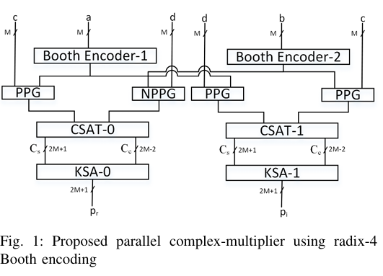

Block Diagram
Strategy: The architecture uses two parallel pipelines to compute the real (p_{r}) and imaginary (p_{i}) parts at the same time.
Key Hardware Blocks:
Booth Encoders: Cut the number of partial products in half and save significant chip area.
(N)PPGs: Generate the actual partial product rows.
Carry-Save Adder Trees (CSAT): This is the core of the speed-up. It combines all partial products and reduces them to just two words in one fast, parallel step.
Kogge-Stone Adders (KSA): Perform the final high-speed addition.
Real part:
Imaginary part:

Slide 7

Design Procedure
Real part:
Imaginary part:
This paper introduces a new architecture built on two clever hardware optimization techniques:
Radix-4 Modified Booth Encoding (MBE): A powerful algorithm to cut the number of partial product rows in half, immediately reducing the amount of work to be done.
Distributed Arithmetic (DA) with a Carry-Save Adder Tree: A structural change to eliminate the slow "two-stage adder" by combining all calculations into a single, highly efficient addition process.
Now, we will discuss these techniques in detail.

Slide 8
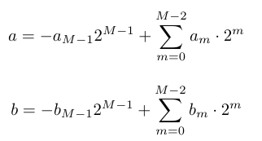
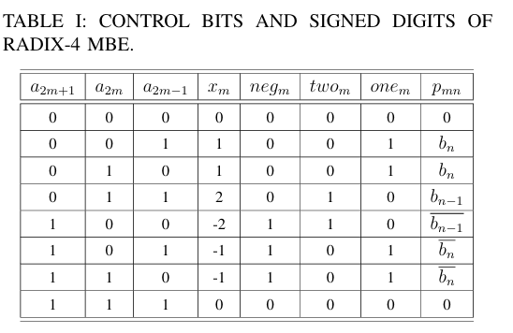




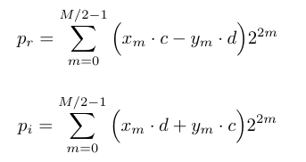
Design Procedure: Radix-4 Modified Booth Encoding
2’s complement Representation for a and b:
Radix-4 MBE Representation:
Where x_{m} belongs to the signed digit set {−2,−1,0,1,2} given by
On substituting a and b in Radix-4 Modified Booth Encoded form, expressions for real and imaginary part are given by:
Modified Booth Encoding (MBE) efficiently reduces the number of partial products—halving multiplication complexity compared to direct multiplication of operands.

Slide 9
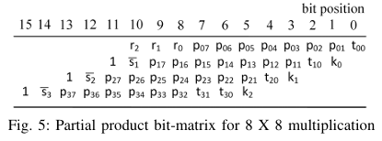
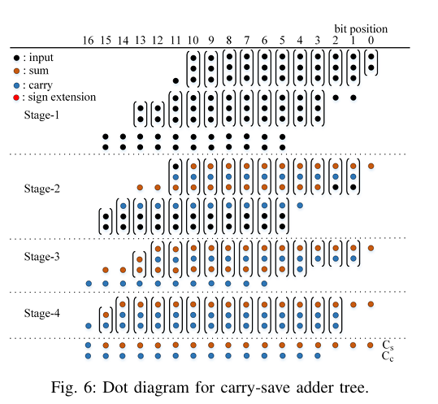
Design Procedure: Distributed Arithmetic with a CSA Tree
Core Idea: We avoid separate, slow calculations by grouping all partial products from both ac and -bd together from the start.
Booth Encoding's Role: First, Booth Encoding slashes the number of rows for each multiplication in half (from M to M/2).
The Adder Tree's Job: The Carry-Save Adder Tree (CSAT) takes this combined stack of M total rows and efficiently compresses it into just two final words (a Sum and a Carry), which are further used to calculate final real/imaginary part using Kogge Stone Adder.
Why it's Faster: This "one-shot" reduction process is massively parallel and avoids the extra delay of a second adder stage found in older designs.

Slide 10
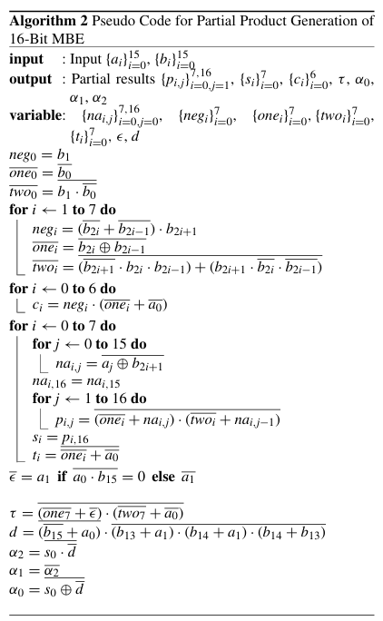
Design Procedure: Overview
Goal: Produce MBE partial products for ac, −bd, ad, bc using modular blocks.
Booth encoder: Converts triplet:
{a_{{2m+1},}, a_{{2m}}, a_{{2m−1}}} → (neg_{m}, one_{m}, two_{m}).
Two identical encoders: one for a, one for b.
PPG: Outputs p_{{m,n}} from operand bit d_{m} and control bits neg_{m}, one_{m}, two_{m}. Gate cost: 1 XNOR, 2 OR, 1 NAND.
Indices: m = 0, …, M/2−1, n = 1, …, M−1.
Reuse & sign: Same encoder + PPG cells generate all partials; use an NPPG variant to produce negative partial products (e.g., −bd).
Takeaway: Small, identical Booth‑encoder and PPG sections enable an efficient, reusable radix‑4 MBE multiplier.

Slide 11
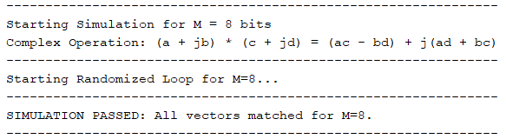
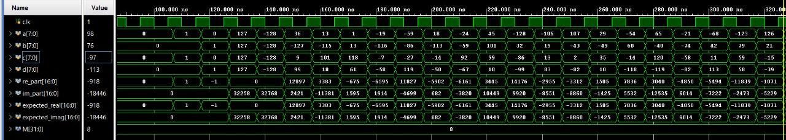
Simulation Results
The simulation uses a parameterized, self-checking testbench that applies directed and randomized input vectors, computes the expected complex product using an internal golden model, and reports mismatches between expected and DUT outputs.
M=8

Slide 12
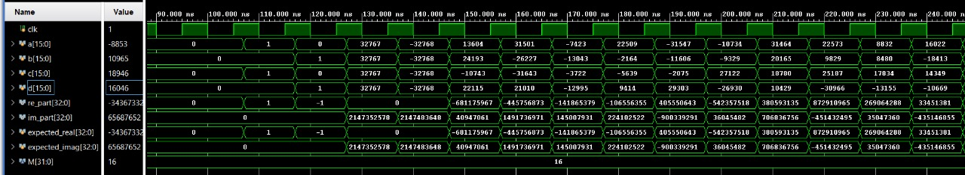
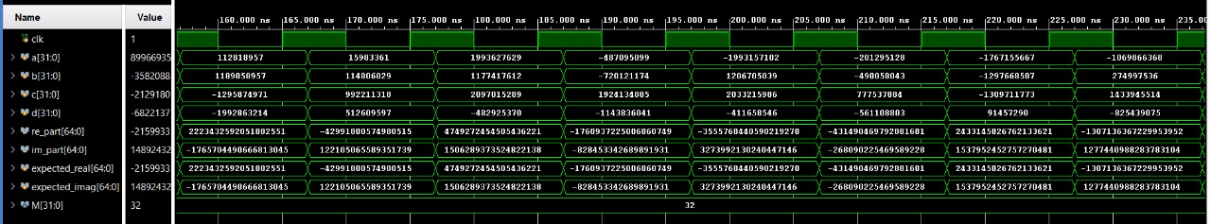
Simulation Results (Continued)
M = 16
M = 32

Slide 13
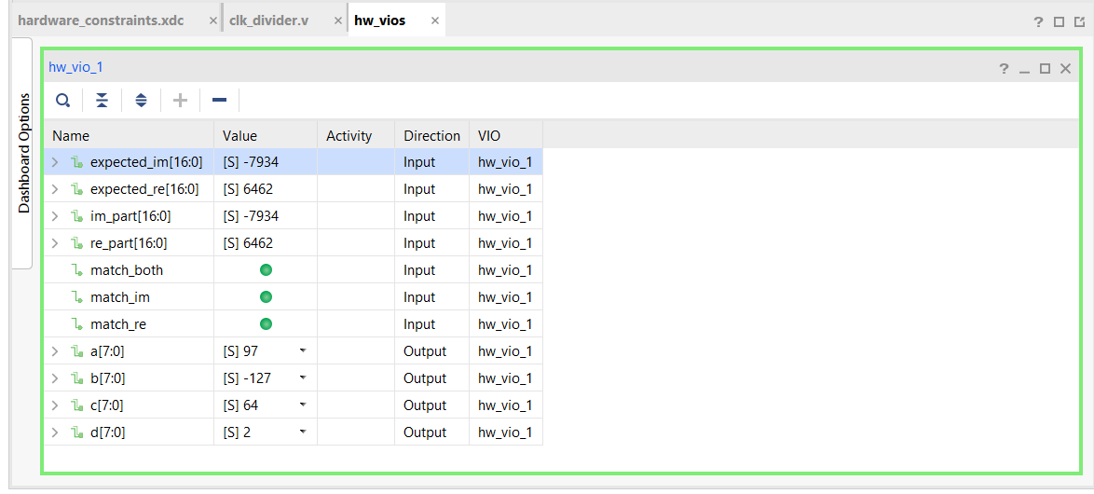
FPGA implementation (M = 8 bits)
The 8-bit complex multiplier was deployed on a Zynq-7000 FPGA using a Vivado block design with a VIO (Virtual Input/Output) core. The VIO allowed us to drive inputs a, b, c, and d directly from the GUI and observe real part (re_part) and imaginary part (im_part) in real time. The VIO outputs were connected to the multiplier inputs, while the multiplier results were looped back into VIO probes for live monitoring.
This setup enabled rapid validation on hardware without any external switches, confirming correct functional behaviour for all tested values.

Slide 14
Comparison with other designs
Context: Compared a multiplier-based complex multiplier (proposed design: two-stage adder with vector merging adder + final adder) against [4]'s baseline on Zynq-7000 using Vivado for ASICs/FPGAs.
[4] R. C. Ismail and R. Hussin, “High performance complex number multiplier using Booth-Wallace algorithm,” in Proc. IEEE International Conference on Semiconductor Electronics, 2006, pp. 786–790.
Targets: Post-layout focus on LUTs and power at 50 MHz clock (EPC area/power optimized).
Big Picture: Given design slashes delay (~23% avg) and power (~22% avg) via efficient adder staging—perfect for scaling to 32-bit ops without blowing resources.
Architecture | Word Length | LUTs | Power (mW)
 | 8 | 401 | 9
Design of [4] | 16 | 1678 | 27
 | 32 | 5990 | 55
 | 8 | 387 | 8
Proposed Architecture | 16 | 1504 | 19
 | 32 | 5650 | 47

Slide 15
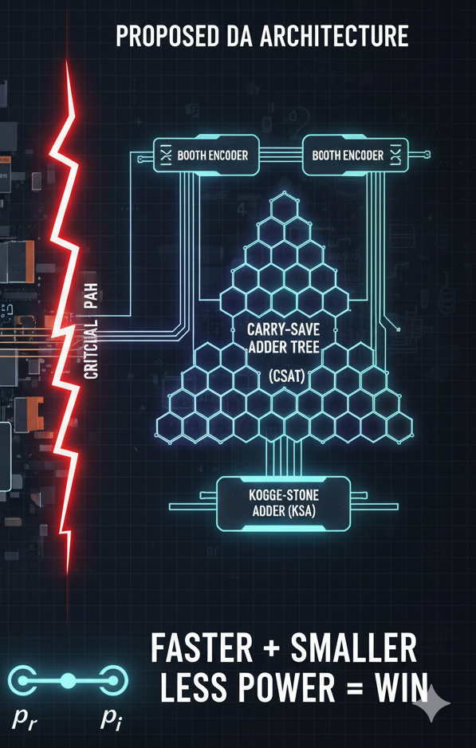
Conclusion
The Problem: High-performance complex multiplication is a critical but challenging task in hardware design - DSP, communications, AI, and scientific computing. Existing architectures incur overhead due to large partial product arrays and two-stage addition.
The Solution: This paper presented a novel architecture that achieves superior performance through two key innovations:
Radix-4 Booth Encoding to halve the number of partial products.
A Distributed Arithmetic approach that combines calculations into a single, highly parallel reduction tree, eliminating a major speed bottleneck.
The Impact: The design is proven to be faster, smaller, and more power-efficient, providing a powerful building block for the next generation of DSP, communications, and AI hardware.

Slide 16
Reference
[1] M. Hemnani, S. Palekar, P. Dixit, and P. Joshi, “Hardware optimization of complex multiplication scheme for DSP application,” in Proc. Inter national Conference on Computer, Communication and Control (IC4), 2015, pp. 1–4.
[2] K. D. Rao, C. Gangadhar, and P. K. Korrai, “FPGA implementation of complex multiplier using minimum delay vedic real multiplier architec ture,” in Proc. IEEE Uttar Pradesh Section International Conference on Electrical, Computer and Electronics Engineering (UPCON), 2016, pp. 580–584.
[3] V. Oklobdzija, D. Villeger, and T. Soulas, “Considerations for design of a complex multiplier,” in Proc. Conference Record of the Twenty-Sixth Asilomar Conference on Signals, Systems & Computers, 1992, pp. 366 370 vol.1.
[4] R. C. Ismail and R. Hussin, “High performance complex number multiplier using Booth-Wallace algorithm,” in Proc. IEEE International Conference on Semiconductor Electronics, 2006, pp. 786–790.
[5] Z. Chen, Y. Du, B. Cheng, and W. Shan, “Design of high-efficiency complex multiplier for fault-tolerant computation,” Integration, vol. 90, pp. 190–195, 2023.
[6] M. Manimaraboopathy, G. Kumar, and M. Bennet, “Design and imple mentation of multiplier for complex numbers using CORDIC (COordinate Rotation Digital Computer) architecture,” International Journal of Pure and Applied Mathematics, vol. 119, pp. 159–164, 01 2018.
[7] D. M. T. Nguyen, P. M. M. Nguyen, H.-T. Ngo, and M.-S. Nguyen, “Design and implementation of complex multiplier with low power and high speed,” in Proc. 15th International Conference on Advanced Computing and Applications (ACOMP), 2021, pp. 215–219.
[8] Z. Huang and M. Ercegovac, “High-performance low-power left-to-right array multiplier design,” IEEE Transactions on Computers, vol. 54, no. 3, pp. 272–283, 2005.
[9] S. R. Kuang, J. P. Wang, and C. Y. Guo, “Modified Booth multipliers with a regular partial product array,” IEEE Transactions on Circuits and Systems II: Express Briefs, vol. 56, no. 5, pp. 404–408, 2009.

